Slide 1
IndigeQuit
American Indian and Alaska Native Cultural Adaptation of a Smartphone Application for Commercial Cigarette Smoking Cessation
Hershel Clark, MPH (Navajo Nation)
Chase Kornacki, MPH (Navajo Nation)

Slide 2
Disclosures
This study is supported by NIH, National Cancer Institute, under grant R01 CA284687 (PI: Dr. Jonathan Bricker).

Slide 3
About Us
Community Advisory Board members for IndigeQuit project
Hershel Clark, MPH
Navajo Nation
2013-2025 Black Hills Center for American Indian Health
Co-Founder of Air is Life Coalition
Health, Wellness, & Consulting LLC, Present
Chase Kornacki, MPH
Navajo Nation
2022-2026 Project Coordinator for a Southern California Tribal Clinic, tobacco prev/cessation
Incoming first-year medical student at University of North Dakota

Slide 4
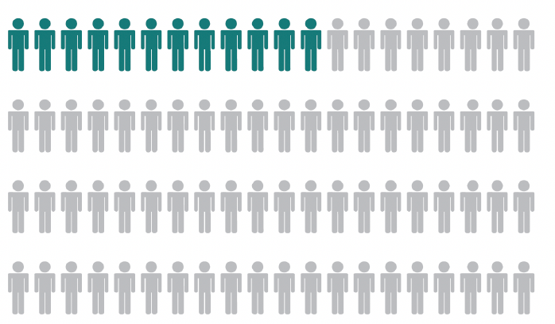
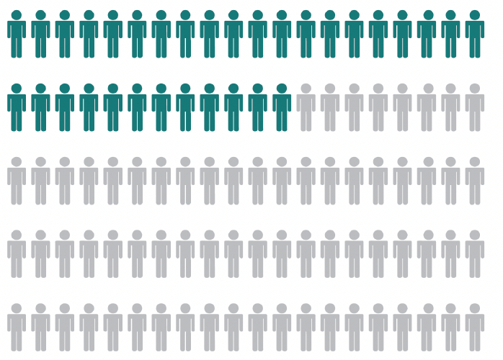

Cigarette Smoking among AIAN Communities
Due to the colonization of tobacco plants by European settlers and the subsequent intensive marketing of commercial tobacco products to AIAN people, AIAN people smoke commercial cigarettes at three times the U.S. average (36.5% vs. 11.5%).
non-AI/AN adults
AI/AN adults
Notes:
We know that AIAN people are disproportionately affected by the use of commercial tobacco due to colonization, systemic racism, historical trauma, and targeting by the nicotine and tobacco industry.
In 2021, nearly 12 of every 100 U.S. adults aged 18 years or older (11.5%) smoked cigarettes compared to 32 of every 100 AIAN adults.

Slide 5
Smoking-related Harms Among AIAN People
1/2
6x
As likely to quit smoking
Higher rates of developing smoking-related cancers
…calls for creative, accessible, Native-centered resources to quit smoking.
Notes:
AIANs are only half as likely to quit smoking compared to other races/ethnicities.
Compared to other racial/ethnic groups, they have 6 times higher rates of developing smoking-related cancers, including lung cancer, as well as disproportionally higher rates of respiratory and heart disease.

Slide 6
Smoking Cessation Apps
Potential Solution: Smartphone apps deliver evidence-based cessation content without healthcare interactions
Advantages:
  Accessible anytime, anywhere
  Do not always require internet
  More engaging than websites or text messaging

Slide 7
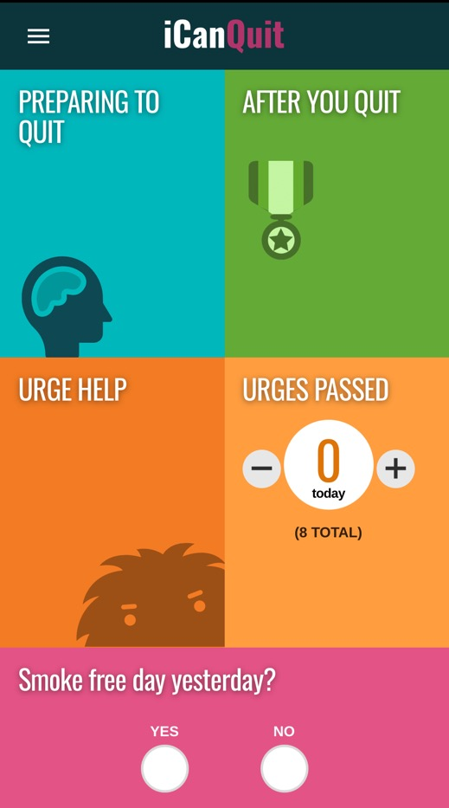
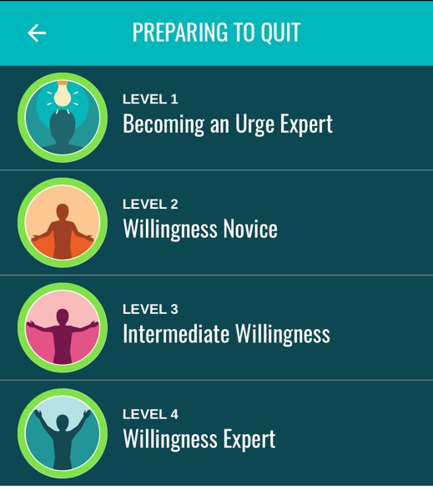
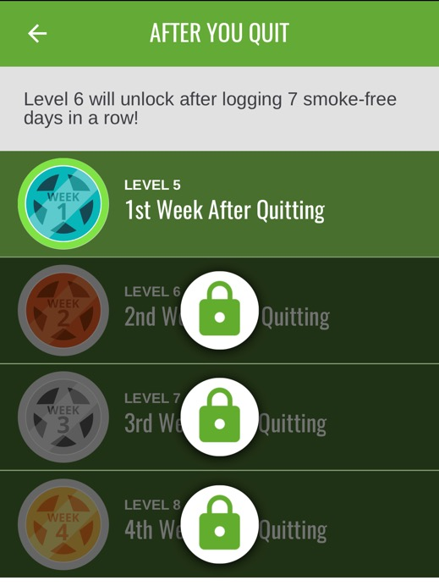
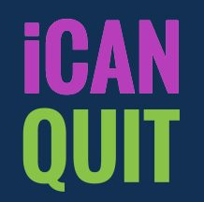
Original App: iCanQuit
Notes:
Evidence-based app developed to help adults in the U.S. quit cigarette smoking
Designed for the general population

Slide 8
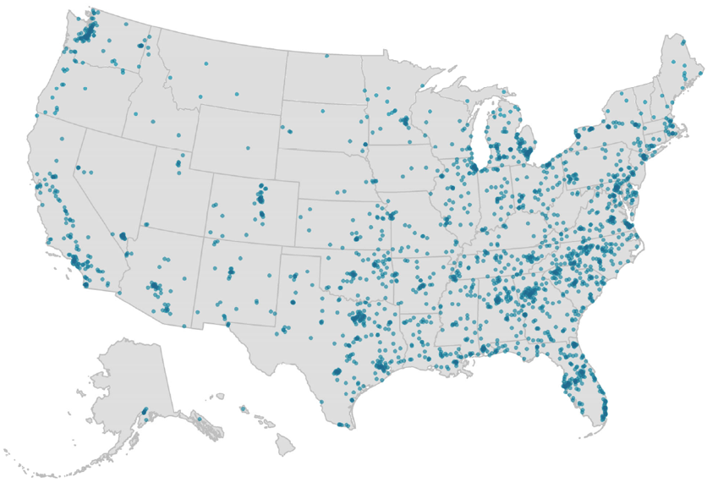
iCanQuit Impact: Reach x Effectiveness
2415 adults from all 50 U.S. states
12-month Quit Rates
28.1%
21.2%
Bricker et al. JAMA IM, 2020;180(11):1472-1480.
Notes:
The first-known smoking cessation smartphone app to demonstrate efficacy in a nationwide, large sample of U.S. adults

Slide 9
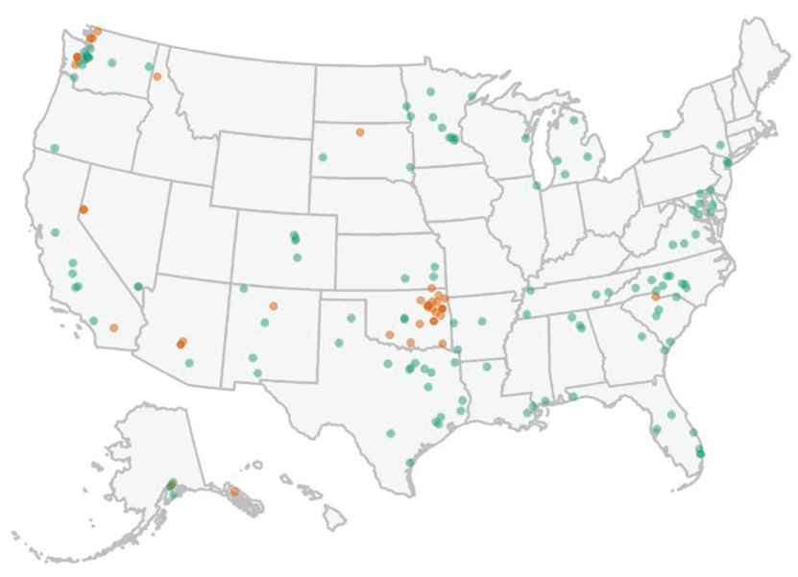
iCanQuit Impact among AIAN participants
169 AIAN adults from 31 U.S. states
12-month Quit Rates
30%
18%
Tribal land (25%)
Non-Tribal land (75%)
Santiago-Torres et al. Nicotine & Tobacco Research, 2021; 24(4): 544-554
Notes:
Subset of AIAN participants benefited → Identified need for cultural adaptation

Slide 10


Acceptance and Commitment Therapy (ACT)
Teaches people how to notice cravings to smoke commercial tobacco and let them pass without giving in, rather than trying to avoid or fight the cravings.
ACT helps people find motivation to quit smoking commercial tobacco by connecting it to what matters most to them—like their health, family, or personal goals.
Notes:
The app is based on Acceptance and Commitment Therapy

Slide 11

The Goal
Original App
New App built for Natives by Natives

Slide 12
IndigeQuit
Culturally tailored app for AI/AN people

Slide 13
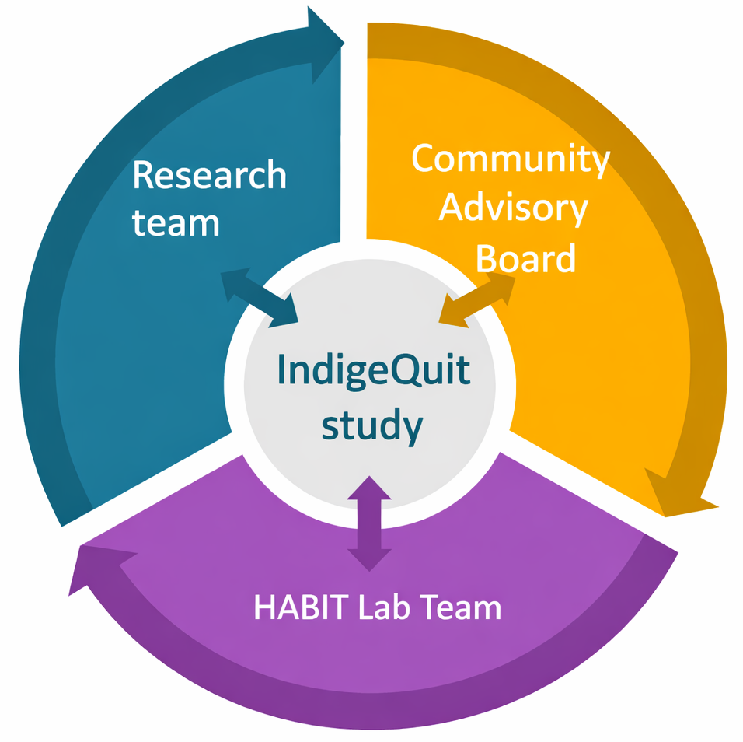

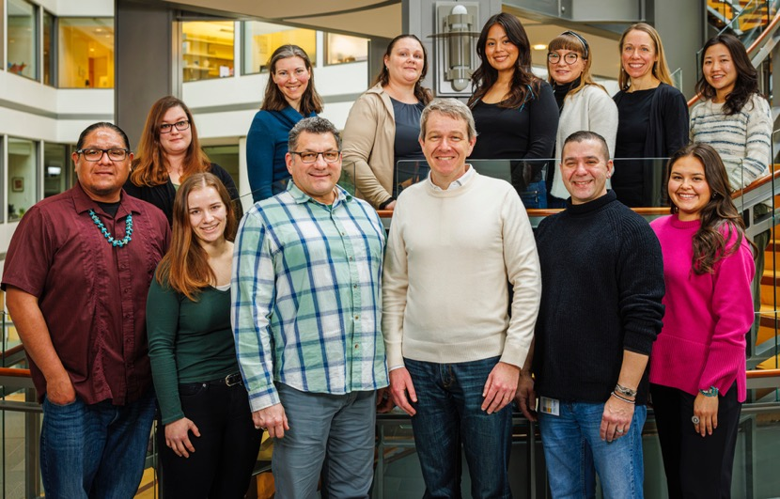
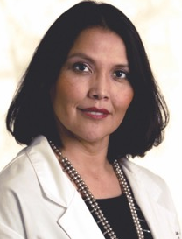
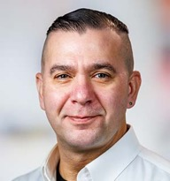
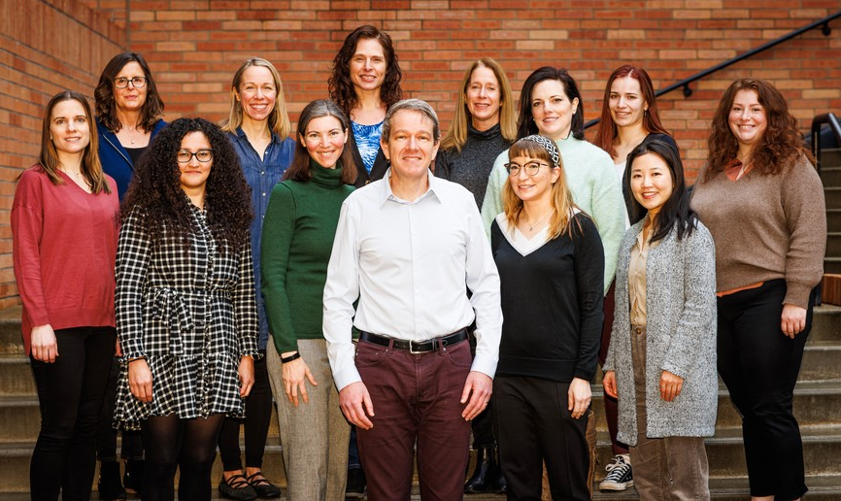
IndigeQuit Study Partnership
Jonathan Bricker, PhD
Fred Hutchinson Cancer Center
Principal Investigator
Community Advisory Board
Patricia Nez Henderson, MD
Diné
Black Hills Center for American Indian Health
Co-Investigator
Lonnie Nelson, PhD
Descendent of the Eastern
Band of Cherokee Indians
Fred Hutchinson Cancer Center
Co-Investigator
HABIT Lab Team
Notes:
CAB
Ensure study materials honor tribal customs and are easy to understand
Help build trust and address concerns about the app, study materials, etc.

Slide 14
User-centered Community-Participatory Design
1) Needed Changes
Explore cultural adaptations of iCanQuit via 1:1 interviews with prior AI/AN participants
6-day diary study with 1:1 interviews of nationally recruited AI/AN adults, informed by the CAB, research and app teams.
3) Beta Testing
Community Advisory Board
2) Prototype Development
Developed and refined prototypes with CAB, research, and app teams; evaluated via 1:1 interviews with prior AI/AN participants.

Slide 15
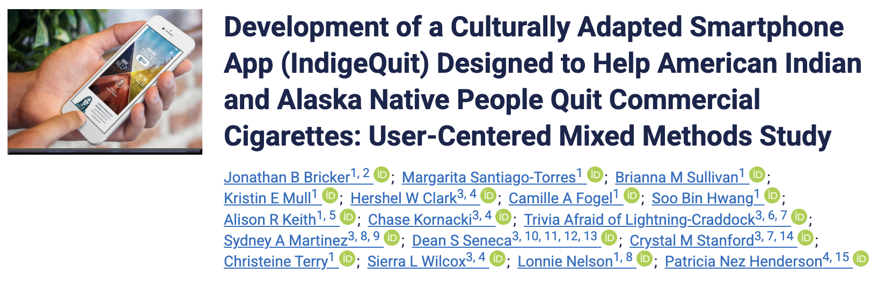
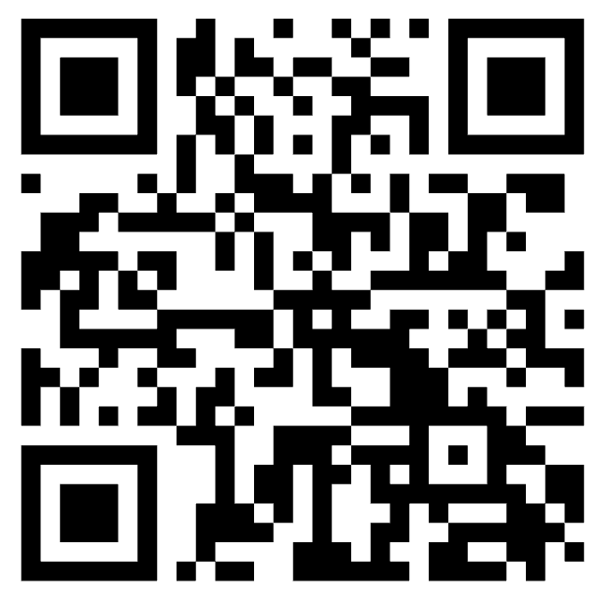
User-centered Community-Participatory Design

Slide 16
Suggested Five Refinements
Modify app’s stories to stories of AIANs who quit smoking, emphasizing the values of spirituality, family, and community
Add the value of honoring the Earth as a motivator to quit smoking
Make the appearance of the app “guide” more representative of AI/AN people
Add information on ceremonial tobacco vs. commercial tobacco
Use earth tone colors

Slide 17
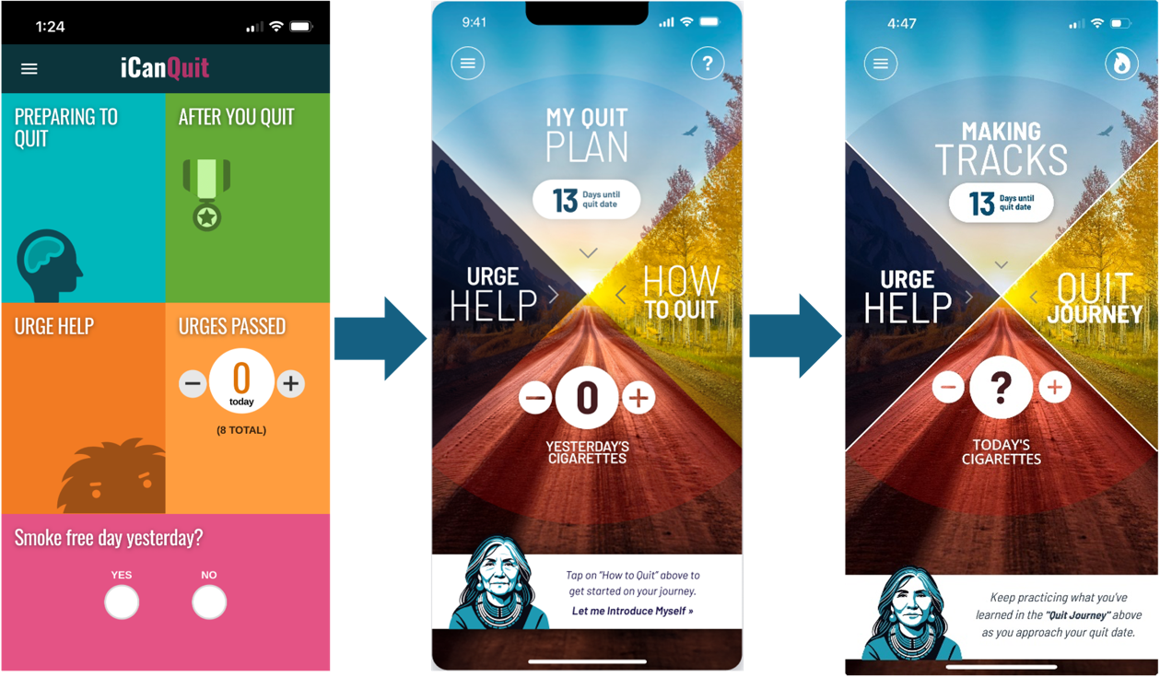
iCanQuit Cultural Adaptation to IndigeQuit
Notes:
Evolution of the app’s home screen across design iterations
Left: original iCanQuit home screen
Middle: early revision informed by participant and CAB feedback to feature the Medicine Wheel
Right panel shows the final revised design

Slide 18
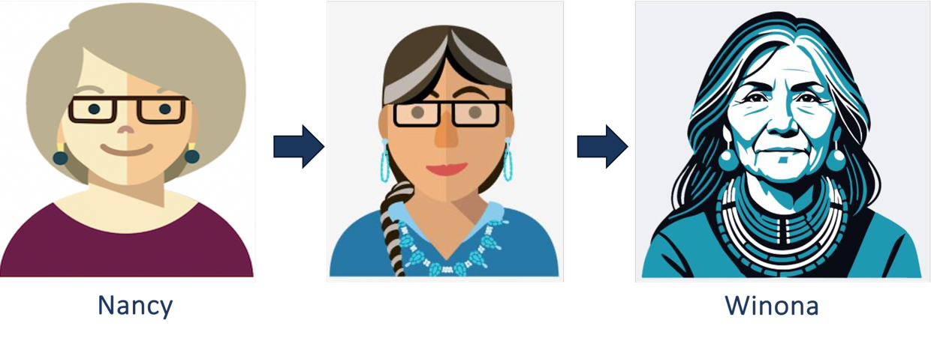
Nancy Evolves Into Winona
Notes:
Guide avatar: The original iCanQuit guide avatar named “Nancy” (left panel) was completely redesigned into “Winona” (right panel), a Native-named elder who would feel more familiar for Native users and be viewed as a source of wisdom and support. The sequence illustrates the evolution of “Nancy” across design iterations.

Slide 19
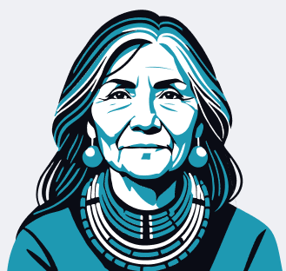
Winona Persona
Early life:
Grew up in community and started family young
Went back to school to earn BA and MA
Currently:
Director of a community health center
Respected as an elder
Credible resource → she quit smoking cigarettes
Tone:
Credibility, compassion, cultural grounding
Balance of authority and warmth
Positive, humorous, and motherly
Notes:
Felt important to CAB for Winona to Blends deep knowledge of local customs and traditions with a formal Western education.

Slide 20

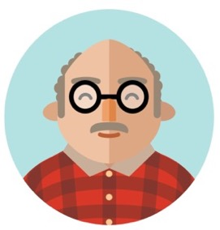

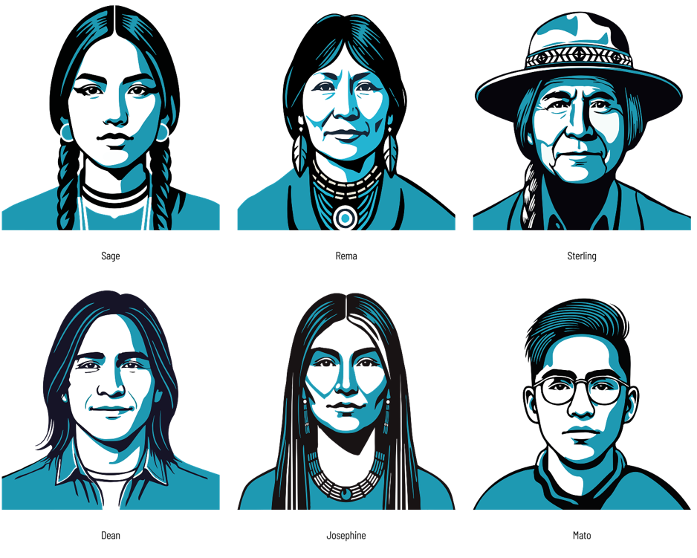



Additional avatars
Ty
Todd
Sharon
Sage
Rema
Sterling
Dawn
Jennifer
Neesha
Dean
Josephine
Mato
Notes:
Additional avatars: The left panel shows the original iCanQuit set of additional avatars. The right panel shows the revised set of avatars developed through iterative design informed by participant and CAB feedback to have Native features, hairstyles, and names.

Slide 21
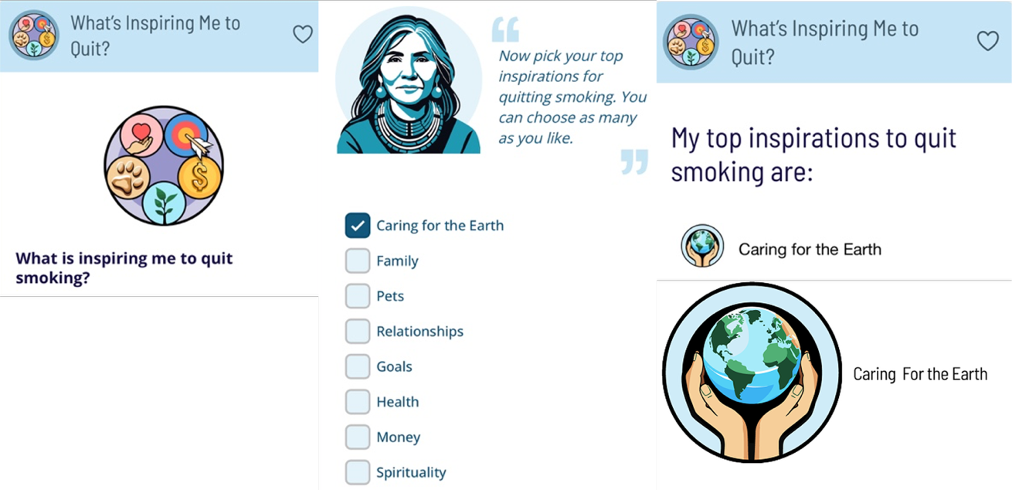
What’s Inspiring Me To Quit?
Notes:
What’s Inspiring Me to Quit?: An interactive feature in which users select one or more personal motivations for quitting smoking from a set of illustrated value-based icons. The values-based motivation iconography was updated to include Native symbols. The ‘Caring for the Earth’ icon, presented here, is meant to emphasize connections between smoking cessation and the role of honoring the earth in supporting balance, health, and responsibility to future generations. Selected inspirations are displayed back to the user to reinforce motivation during the quit journey.

Slide 22
IndigeQuit Inspiration Icons
Caring for the Earth
Relationships
Goals
Family
Traditions
Self growth
Health
Money
Spirituality
Pets

Slide 23
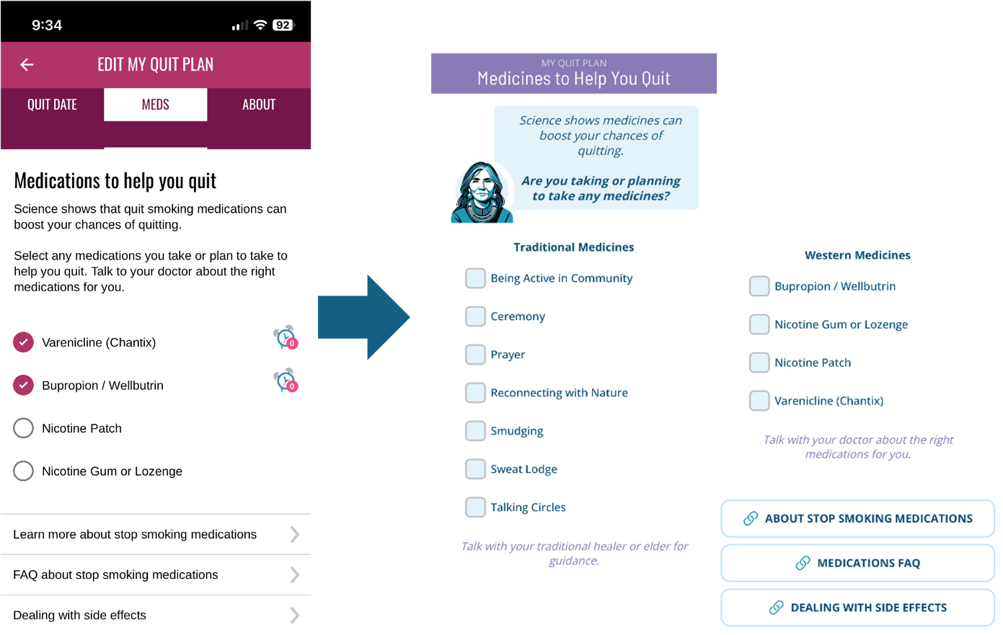
Medicines to Help You Quit
Notes:
Left: original iCanQuit version of the medication tool selection screen, which focused exclusively on Western, pharmacologic smoking cessation treatments
Right:Revised design, which was informed by participant and CAB feedback to distinguish between Western medicines (e.g., nicotine replacement therapy, bupropion, varenicline) and traditional approaches to healing (e.g., ceremony, prayer, reconnecting with nature, smudging, talking circles).

Slide 24
Diary Study Main Results
Most diary participants rated the app as excellent (69.2%) or good/meets expectations (30.8%)
Participants agreed that the app felt like it was made for them
“Right off the bat they're including prayer and ceremony and community. That's not something that you see with the other apps. I really like that, because it felt like being seen and that recognition is there for something that typically isn't recognized…It goes a long way ”
“It actually made it sink in a little bit more too, because after growing up being Native and everything, hearing stories is one of the best ways to learn.”
Notes:
“There's something special about this app that, for Natives, will make it better than any other”
“You could just hit play and close your eyes and think that somebody's sitting there with you and is from your community and is talking to you, which is nice. I liked that.”
“Right off the bat they're including prayer and ceremony and community. That's not something that you see with the other apps. I really like that, because it felt like being seen and that recognition is there for something that typically isn't recognized…It goes a long way ”
“It actually made it sink in a little bit more too, because after growing up being Native and everything, hearing stories is one of the best ways to learn.”

Slide 25
Diary Study Suggested Final Refinements
  Include a vaping FAQ
  Feature motivation icons more prominently
  Increase notifications frequency
  Change tracking cigarettes from yesterdays to today’s
  Mention the app’s tools can also support quitting other substances, such as alcohol

Slide 26
Community Impact
CAB involvement ensured the app was relevant and acceptable
Diverse CAB representation to increase relevance across communities
  Cherokee, Lakota, Navajo, Coast Salish, and Seneca
  Arizona, California, Kansas, New Mexico, New York, Oklahoma, South Dakota, and Washington.
CAB continues to collaborate in the ongoing IndigeQuit RCT.

Slide 27
Recruitment
The IndigeQuit Team is recruiting AIAN adults nationwide to participate in this study comparing IndigeQuit and a non-AIAN specific app
Adults must:
  Identify as AIAN
  Live in the U.S.
  Have smoked (at least a puff) in the last month
  Read English
  Have a smartphone
  Want to quit smoking!

Slide 28
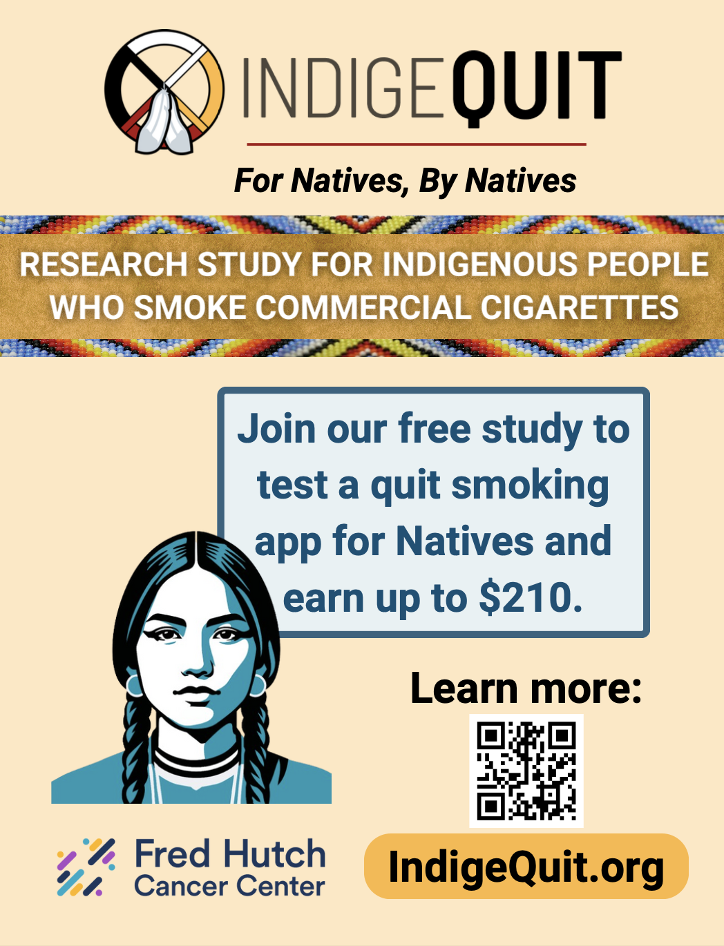

Slide 29
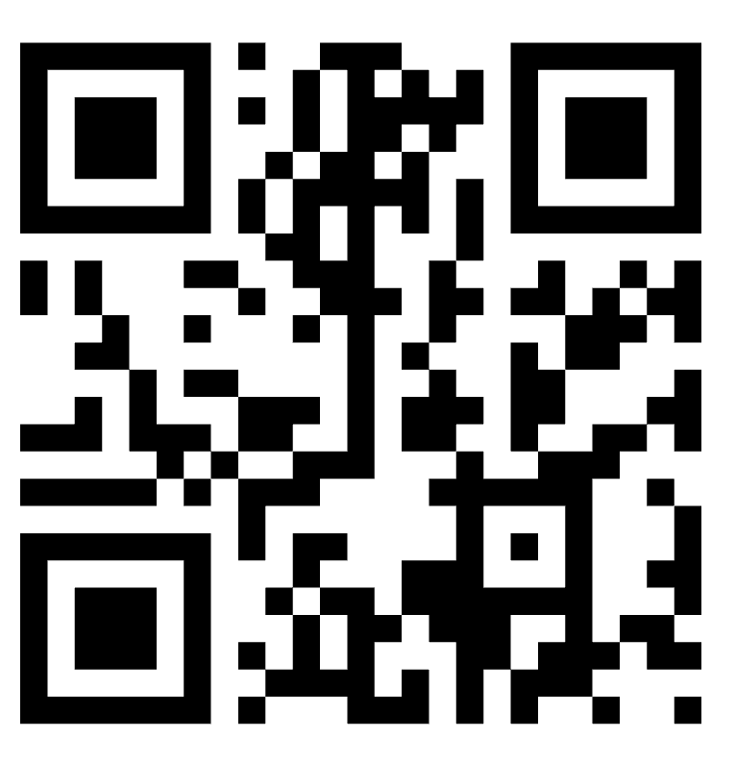
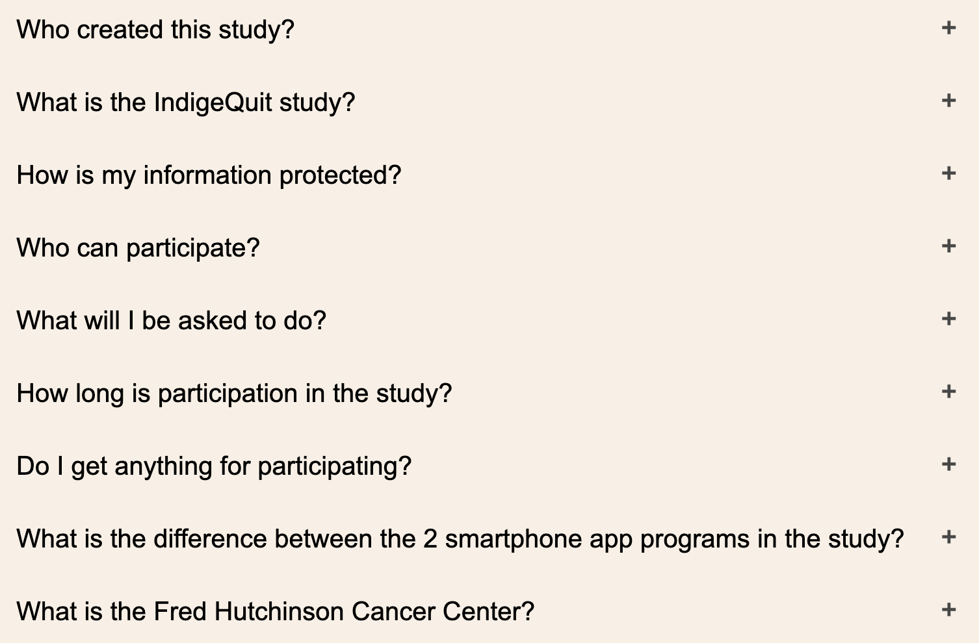
IndigeQuit.org

Slide 30
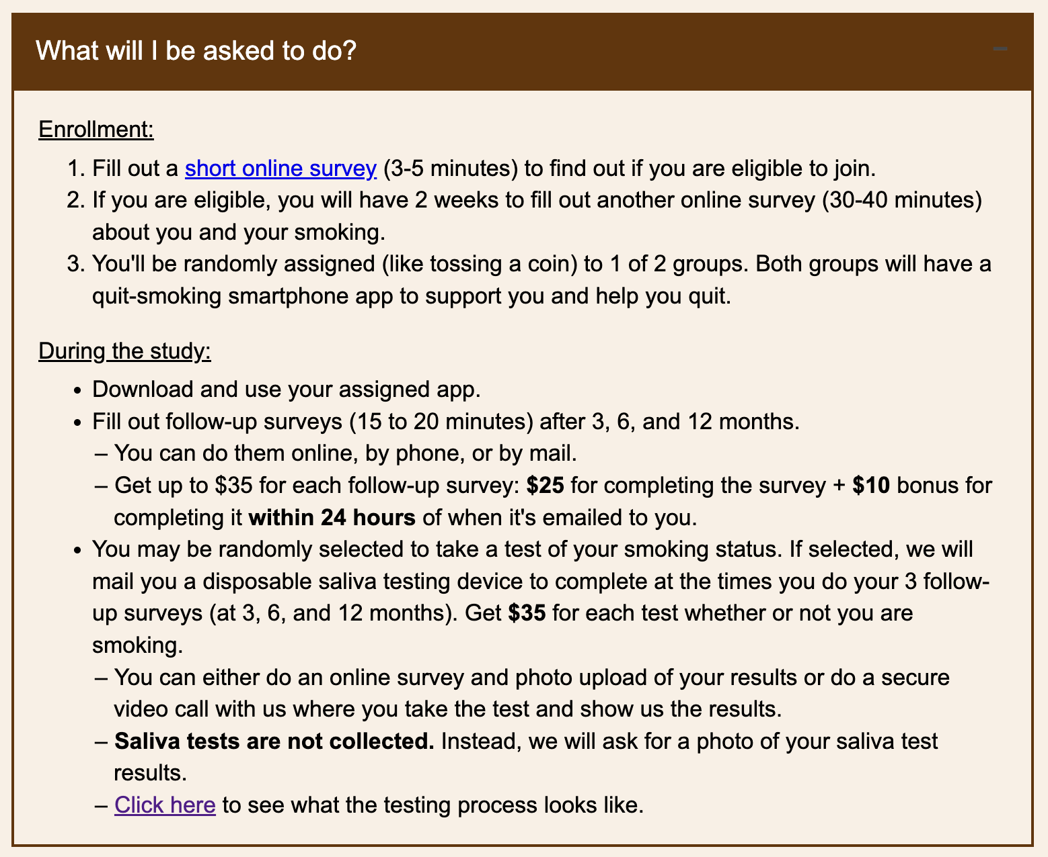

Slide 31
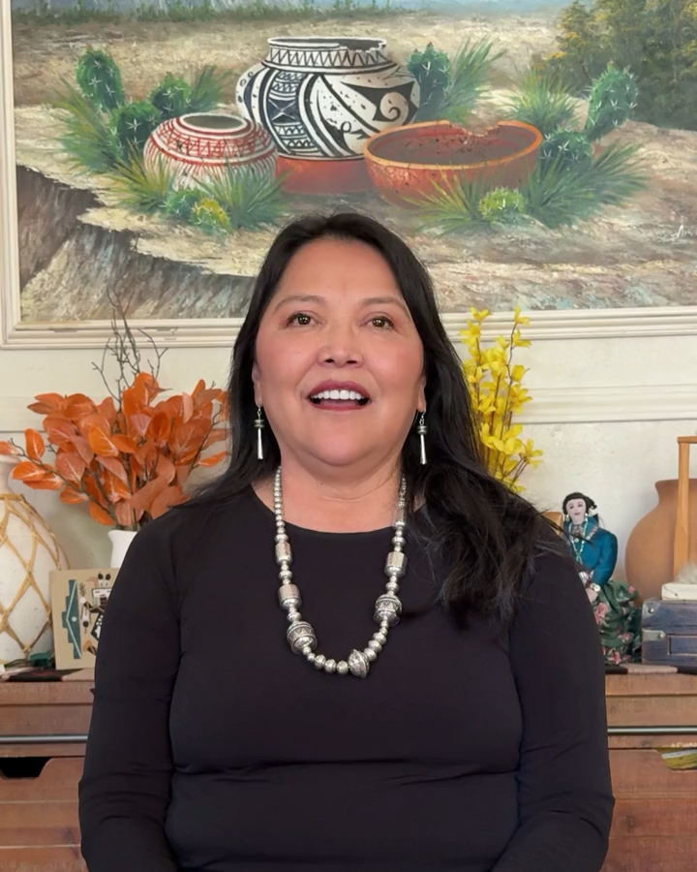

Slide 32
Questions?
Email: IndigeQuit@fredhutch.org

