Slide 1
Developing Tribal Public Health Policies: Practical Strategies for Creating Commercial Tobacco-Free Outdoor Spaces

Slide 2
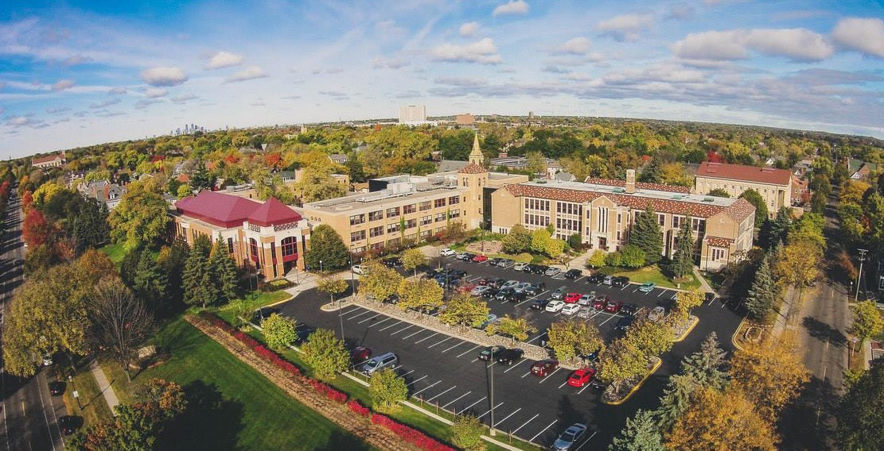

The Public health law center & ETR-Tribal Community Coordinating Center
Notes:
Located at Mitchell Hamline School of Law, in Saint Paul, Minnesota,. We recognize that the Public Health Law Center is located within the traditional homelands of the Dakota people, and that the land we currently occupy comes with a legacy of genocide and trauma caused by U.S. law and policy applied to American Indians.
Help people design public health law and policies grounded in both good science and good law

Slide 3

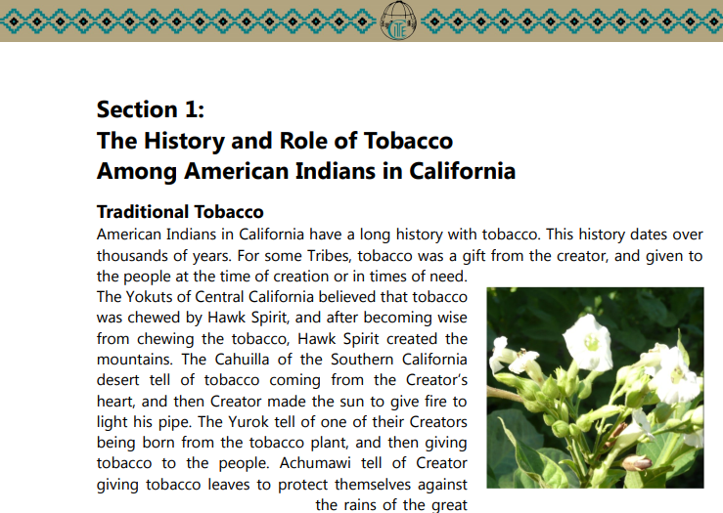
Respecting traditional tobacco
http://www.glitc.org/forms/Tabacco/tabacco-booklet-web-.pdf
http://keepitsacred.itcmi.org/wp-content/uploads/sites/5/2017/09/CommercialTobaccoFreePolicyGuide_MSA_V1.pdf
Notes:
COLIN
COMMERCIAL TOBACCO IS NOT TRADITIONAL TOBACCO. This may not be an issue with every tribe, and it’s different from tribe to tribe. Different tribes use traditional tobacco differently and some may not have a tradition of ceremonial tobacco. Second document published by California Rural Indian Health Board.
Emphasize we’re talking about commercial tobacco, not sacred tobacco use, and even with that, we’re concerned about the most harmful use of it, i.e., smoking or otherwise ingesting it. I understand that some communities or community members may not have access to traditional tobacco and may substitute it with commercial tobacco. So framing your policy around this could be of particular importance.
It can be important to include a definition of commercial tobacco in your community. This is best to come from the community; how to define it; what it includes; and how it is used. For example..some tribal tobacco may not contain any actual tobacco plant in it.
TRANSITION. But if we want to work to reduce the harms of commercial tobacco, it’s important to know how it’s regulated. And a logical place to start looking at it is at the federal level. Now we will look at the Tobacco Control Act.

Slide 4
Agenda:
La Jolla Story
Policy Basics
Community Engagement Activity

Slide 5
La Jolla Success Story

Slide 6
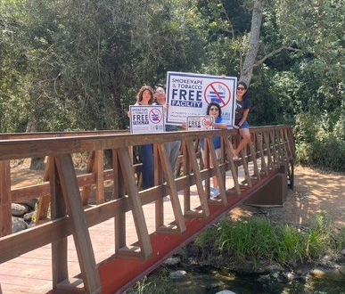
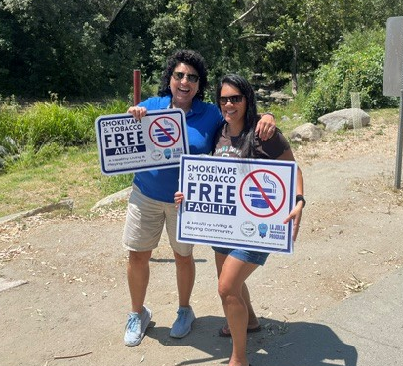
La Jolla Band of Luiseño Indians

Slide 7
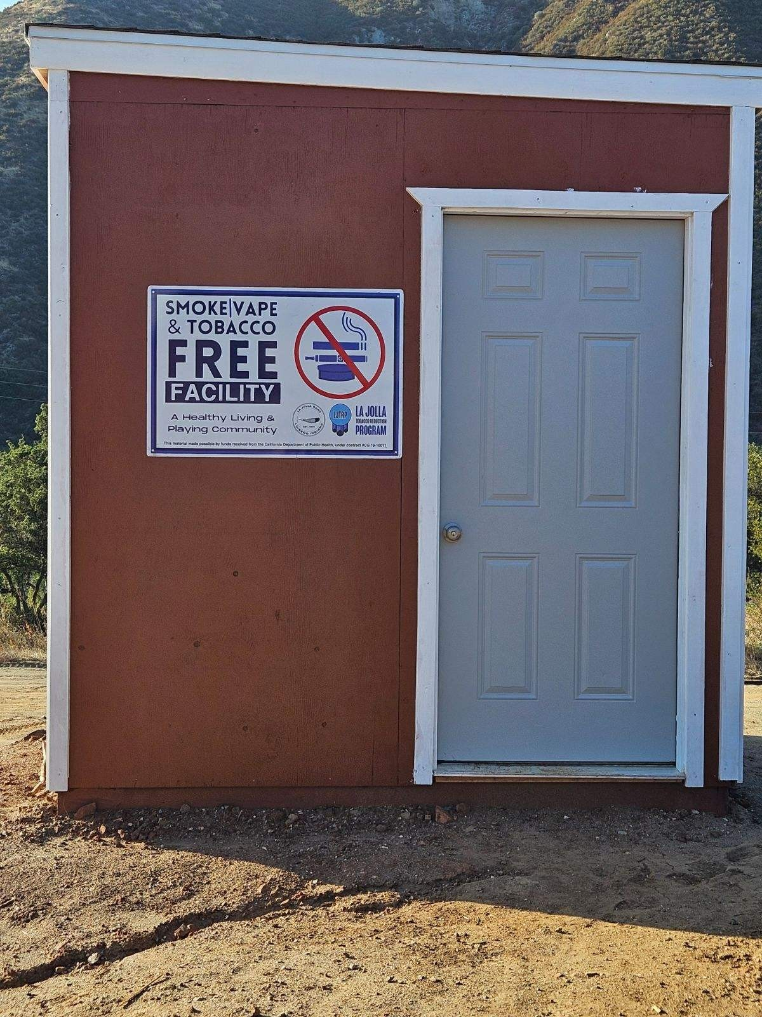
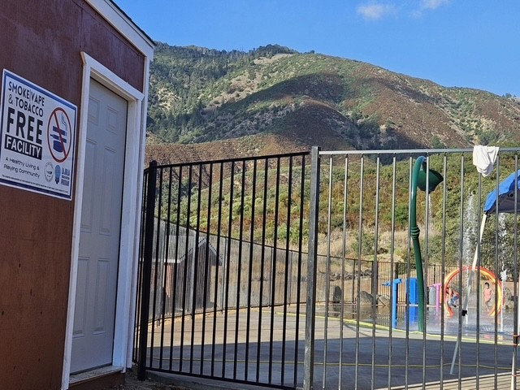
La Jolla Band of Luiseño Indians
7-10 mins

Slide 8
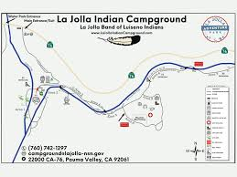
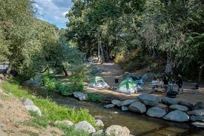
La Jolla Band of Luiseño Indians

Slide 9
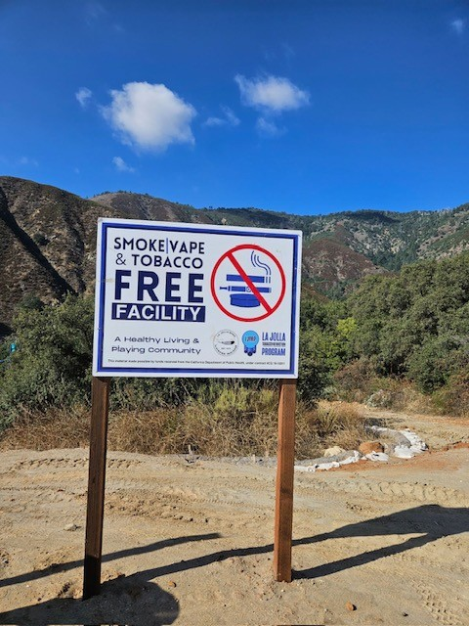
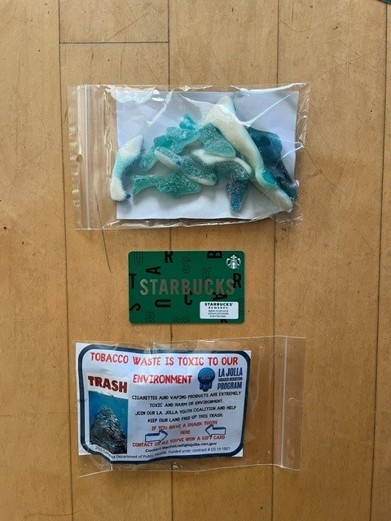
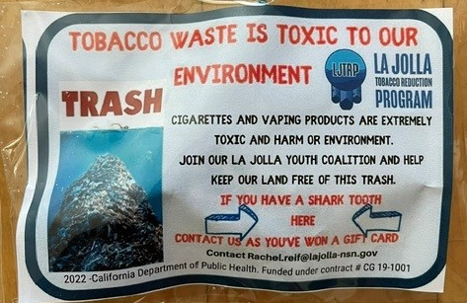
La Jolla Band of Luiseño Indians
7-10 mins

Slide 10
Policy Basics

Slide 11
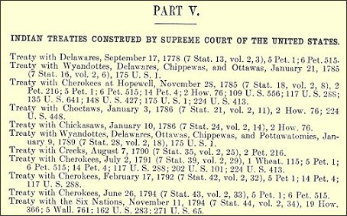
Tribal Law and Authority
Treaties
Executive orders
Resolutions
Ordinances
Codes or code sections
Regulations
Constitutions
Case law
Compacts
Customary law
Notes:
These are the many forms that Tribal law can take,
Treaties are an important source of law, and they can show up in more that one way
A question we often get –what’s the difference between resolutions and ordinances? It varies from Tribe to Tribe—must ask your tribal attorney
Classic roles—resolutions tend to be a statement of intention or support; ordinances/code sections create something that is enforceable. But sometimes resolutions are used to pass codes or ordinances
Ordinances vs. codes -- Using the phrase “code” or “code sections” may bring stronger connotations of sovereignty, in contrast to “ordinances” (which is often used to describe local government laws—laws for cities and counties)
Similar to US federal and state agencies, tribal governments may also have agencies or departments that issue regulations to implement laws

Slide 12

Policy drafting: typical elements
    Findings
    Purpose
    Definitions
    Restrictions/Requirements
      - Exemptions (use with caution)
    Enforcement
Notes:
. . . Review the elements; share how we can assist; begin with gathering findings, defining your purpose, and agreeing on definitions.
The next essential element of a law or policy relates to implementation: how will you notify people of the policy, when does it become effective? A lot of smoke-free laws have 30- or 60-day effective dates to give people time to learn about what’s in the law and make any changes to their establishments that they need. Enforcement addresses the consequences of not complying with the policy and who is responsible for taking action. What actions does the policy require to be taken in case of a violation? It should include a Description of the fines or other penalties that may be imposed. They should be proportionate to the duty; proportionate to the violation; progressively harsh. The policy should specify who is responsible for enforcement. Is it tribal police? Government enforcement? Is there a citizen complaint form? What are the penalties for non compliance? In the context of a smoke-free law, there are different types of penalties you could consider: Graduated Fines for people who smoke, or license revocation for establishments that allow smoking to occur.
Severability. Another key element of a law or policy is severability: If one clause is problematic—a judge can yank that clause and keep/enforce the rest. If a law doesn’t have a severability clause, there’s a risk that the whole law will be thrown out. So, for example, if a city passed a comprehensive smoke-free law, but created an exemption for a bar owned by the mayor, a court might rule that the exemption for the mayor’s bar is a violation of the Equal Protection Clause of the Constitution. If the law has a severability clause, that exemption can get cut out (meaning smoking would also be banned at the mayor’s bar). But if there isn’t a severability clause, there’s a risk that the whole law would get thrown out, and smoking would be allowed everywhere.
So those are typically the essential elements of a law or policy.

Slide 13
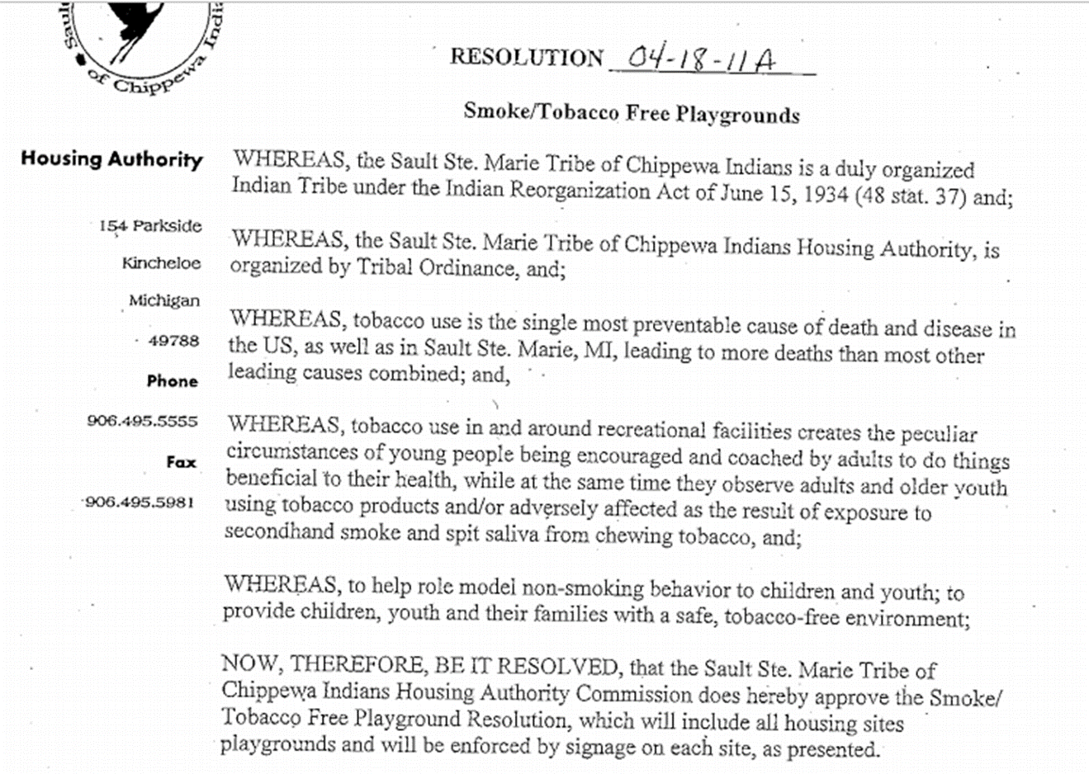
Policy drafting: typical elements
    Findings
Notes:
COLIN
Findings are factual evidence that supports the policy. In the case of smoke-free laws, the Surgeon General’s Report is a great reference. You can also look to other ordinances; Centers for Disease Control reports; Institute of Medicine reports and studies – facts and statistics that establish the need for a change or for action. Findings may help a law withstand a legal challenge. Periodically, communities will tell us “we don’t do findings in our laws.” That’s fine, but there are a couple risks with that approach. The first risk is judicial. If a law is ambiguous, stating that you can smoke in area A, but not in area B, and it’s unclear whether or not the law applies to area C, a judge may look to the findings to determine the intent. So, if the findings state how much of a public health hazard secondhand smoke is, she can decide that smoking should be prohibited in area C, because that is most consistent with the findings. The second risk relates to enforcement. Enforcement authorities may have the same dilemma with regards to area C, and the findings might suggest that enforcement should be broader rather than narrower.
It’s always good to use community-specific findings. If you know the use rates of commercial tobacco or obesity rates are higher in your community than the general population, you should mention that.

Slide 14
Policy drafting: typical elements
    Findings
    Purpose
“This policy has been developed to protect all employees, service users, and visitors from exposure to second-hand smoke. Exposure to second-hand smoke, also known as passive smoking, increases the risk of lung cancer, heart disease and other illnesses.”
Big Valley Rancheria’s Smoke-Free Facility Policy, available at
http://keepitsacred.itcmi.org/wp-content/uploads/sites/5/2017/09/CommercialTobaccoFreePolicyGuide_MSA_V1.pdf
Notes:
COLIN
The Statement of Purpose or of goals or of intent: This is an explanation of what the organization wants to accomplish in terms of policy, systems and environmental change. This part should be directly linked to the findings section. The policy goals and purpose should address the evidence in the findings and make it clear that the purpose is addressing those findings.
Here is the purpose statement from Big Valley Rancheria’s Smoke-Free Facility Policy. The goal is to protect employees, service users, and visitors from secondhand smoke exposure.

Slide 15
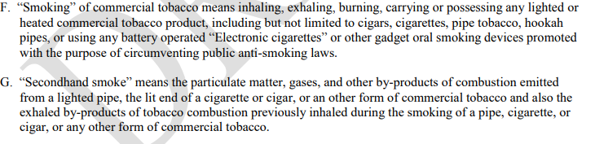
Policy Drafting: Typical Elements
Definitions
From: Cheyenne River Sioux Tribe “Smoke-Free Air Act”
Notes:
COLIN
Definitions—explains the key concepts and words used in the law or policy.
Example from the Muscogee Creek Nation Health Policy
Take a few minutes to jot down some thoughts about this definition—pls put them in the chat
What are some strengths of this definition?
Is there anything confusing about this definition?
What are some ideas for how you might change this definition?
Defining Traditional Tobacco
Commerical tob—use tradi
TOBACCO USE: *Includes but not limited too… CHEWING TOBACCO, ECIGARETTES, HOOKAY EtC
STAFF: use employees as mentioned in purpose…temporary, consultant, volunteers, vendors, and/or contractors.

Slide 16
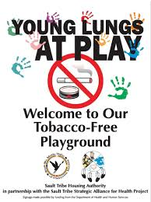
Policy drafting: typical elements
    Findings
    Purpose
    Definitions
    Restrictions/Requirements
      - Exemptions (use with caution)
“The Sault Tribe’s policy has been adopted to establish a tobacco-free environment at all playgrounds found within the Sault Tribe Housing Authority sites.”
Notes:
COLIN
Definitions are very important, particularly when you want to distinguish between commercial and traditional tobacco. I showed an example of that from the Cheyenne River Sioux Tribe in the context of being specific.
Restrictions or requirements: This is the heart of the policy – provisions that promote, control or restrict action. This should clearly state who the policy applies to, what activity is being promoted, controlled or restricted and the responsibilities of affected parties. Telling people they can’t smoke in a public place is an example of a restriction. Telling restaurant owners that they have to post no smoking signs is an example of a requirement. Here’s an example from the Cloverdale Rancheria of Pomo Indians.
Exemptions; are the exceptions to the restrictions and requirements. As with all the other areas, this section should be very clear on the individuals, organizations or locations that are exempt from the provisions. Some smoke-free laws allow smoking to occur in private clubs or casinos. I’ll talk a bit about the advisability of doing this in a bit, but those are examples of exemptions. You’ll want to use them with caution since they can undercut both the argument behind a law, as well as the law itself. Here’s an example of an exemption from the Karuk Tribe; they allow smoking in the multi-purpose room where Bingo is played.

Slide 17

stages of Public Health Law & Policy enforcement and evaluation
What’s working? What’s not working?
  Without creating more burden for impacted community members, evaluate and monitor how the policy is affecting health equity and other equity goals.
  Relevant factors for understanding impact on the causes of inequity
Notes:
You’ll want to evaluate the policy to make sure it’s not creating more burdens for community members. You’ll want to know what the relevant factors are that could cause further inequity and potential address them with a new policy campaign.
TRANSITION. Julie will now summarize these materials.

Slide 18
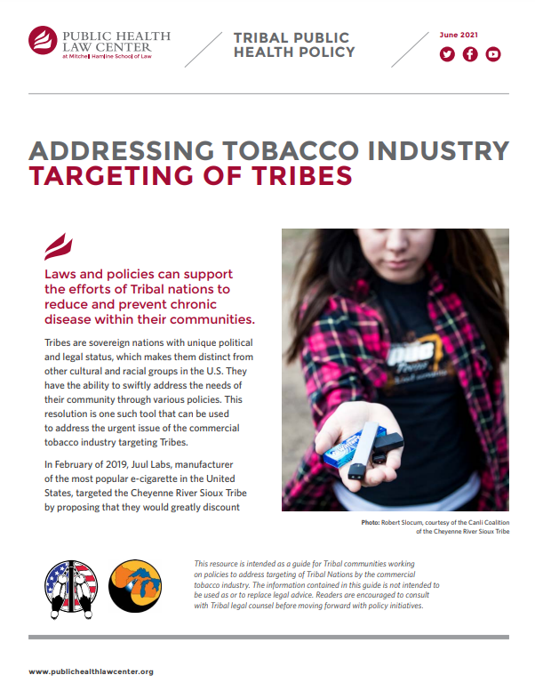
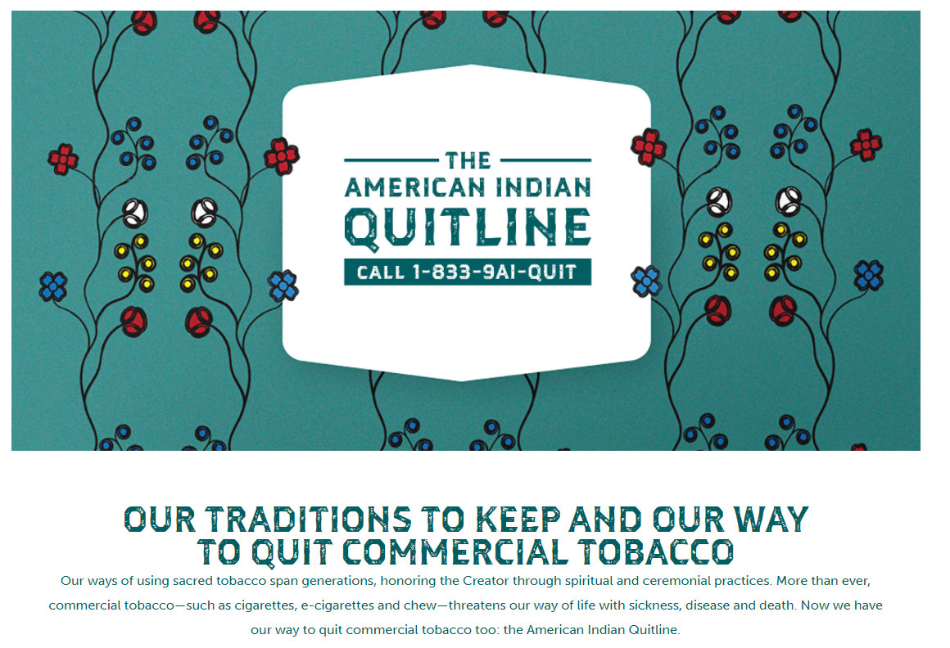
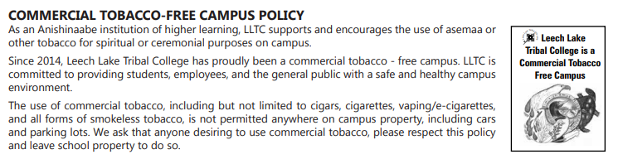
Cessation support
Education
Policy
Notes:
For example, clinical nicotine cessation programs and services are an essential component for effective implementing of policies to reduce harmful commercial tobacco uses. Providing these services helps people feel supported in quitting harmful smoking of commercial tobacco, and vaping of nicotine products. And for Tribes where tobacco is sacred, programs that educate and support sacred uses of tobacco have been shown to support quitting of harmful commercial tobacco use. For youth, programs that help youth to understand how Big Tobacco, including e-cigarette companies like Juul, have targeted them and misled people about the addictiveness and harms of their products, can help people resist the marketing. These programs make smoke-free policies (except for sacred uses of tobacco) more effective because they provide options and support people in being successful.

Slide 19
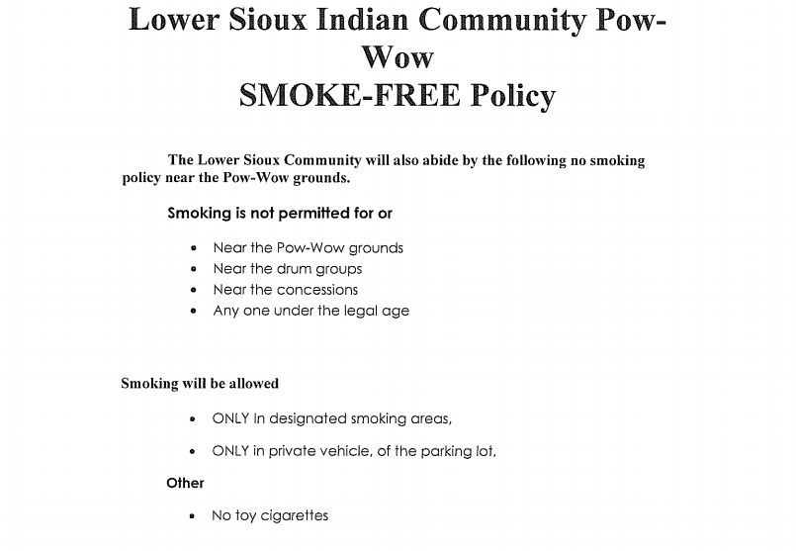
Policy drafting: key principles
Be collaborative
Be practical
Be clear and specific
Be concise
Notes:
COLIN
These are some general drafting tips. Some of them may seem to conflict, like the goal to be concise, and the goal to be specific.
Be collaborative. Involve stakeholders. By “stakeholders,” I mean people who can influence the outcome of your campaign, either positively or negatively. As far as enforcement agencies go, you’ll want to work with them from early on in the campaign, and do education early on. Who the people are will vary by tribe, and you’d know better than I who the best people to get on board are to make sure the law is enforced.
Be practical. Although many laws over the last quarter century created smoking and no smoking sections, we’ve come to realize that it’s impossible from the standpoint of practicality to do that. Secondhand smoke will travel from one section to the other and create a health hazard even in no smoking areas. People have said creating no smoking section is like creating a peeing and no peeing section in a pool. It just doesn’t work. You need to be practical. Another aspect of being practical is knowing what works in your community. In North Dakota, it’s reasonable to drive two-and-a-half hours to a grocery store. But that may not work for New York City. You need to know what works in your community when public health laws and policies as well. Requiring new or reconstructed streets to contain bike lanes like this might be appropriate in New York City, but it may not be in a rural area. In those areas, a wide shoulder might be sufficient to accommodate bikes.
Be clear and specific. The more specific you are, the more clear it will be what is covered by a law and what isn’t. A good example is the distinction between commercial and traditional tobacco.

Slide 20
Community Engagement Activity

Slide 21
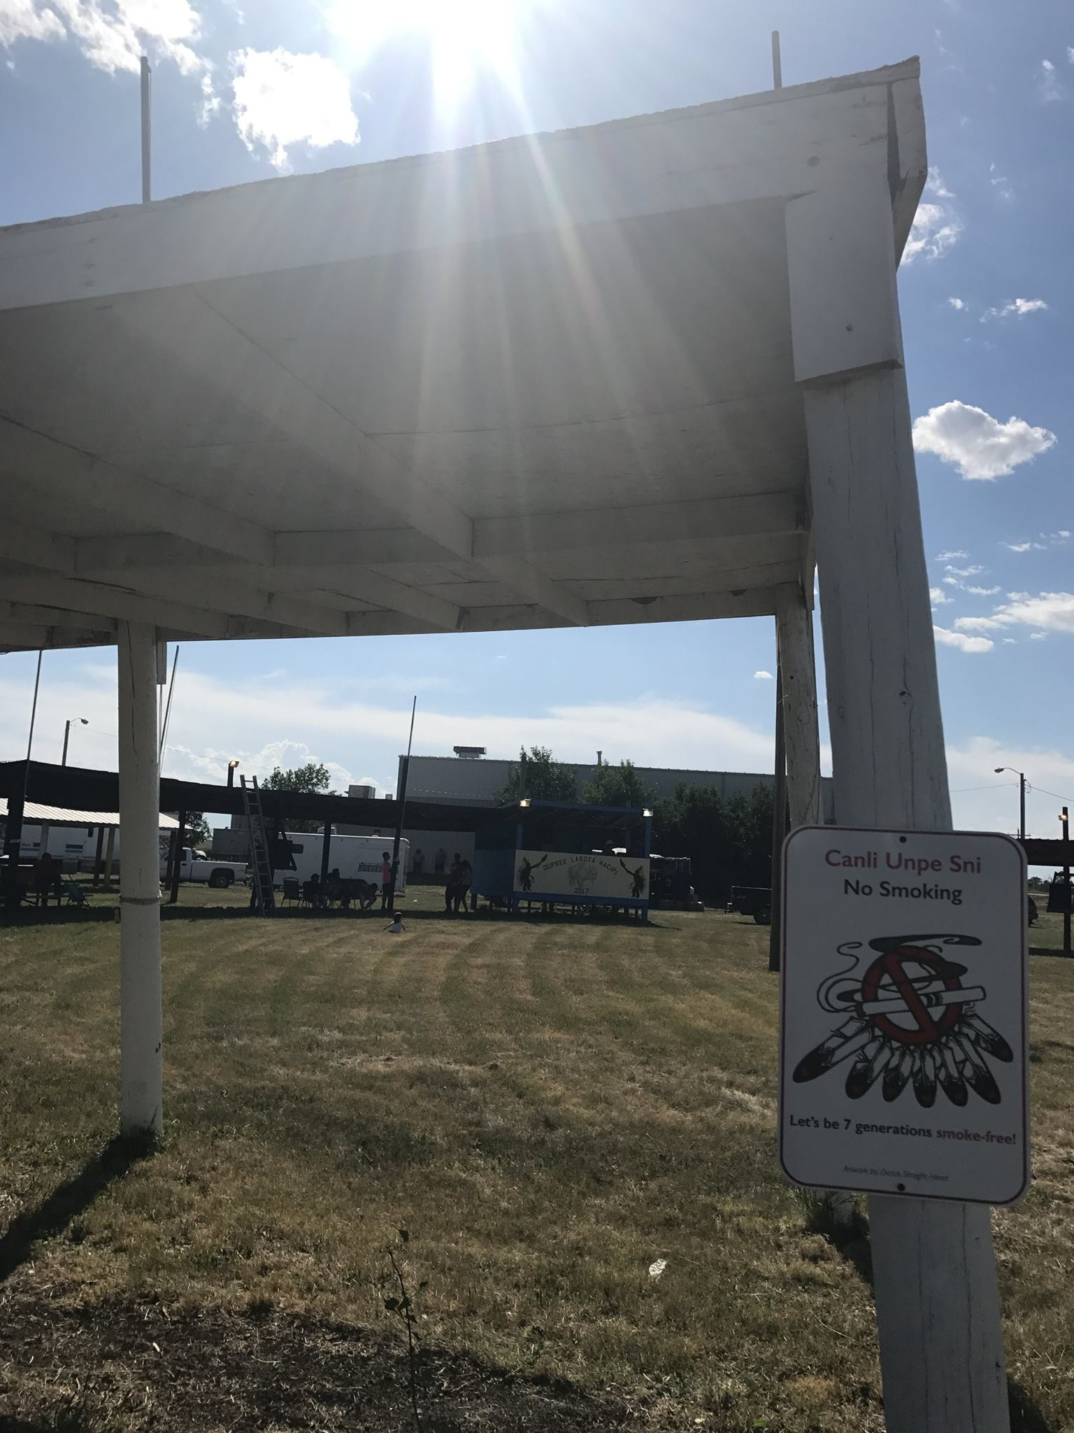
Community engagement activity
Interactive & Quick (5 minutes at each)
Rotating around the room responding to prompts at each flipchart
4 Areas to consider:
  Cultural Area or Ceremonial Grounds
  Health Center
  Recreation areas (Ball fields, campgrounds, etc.)
  Body of Water

Slide 22
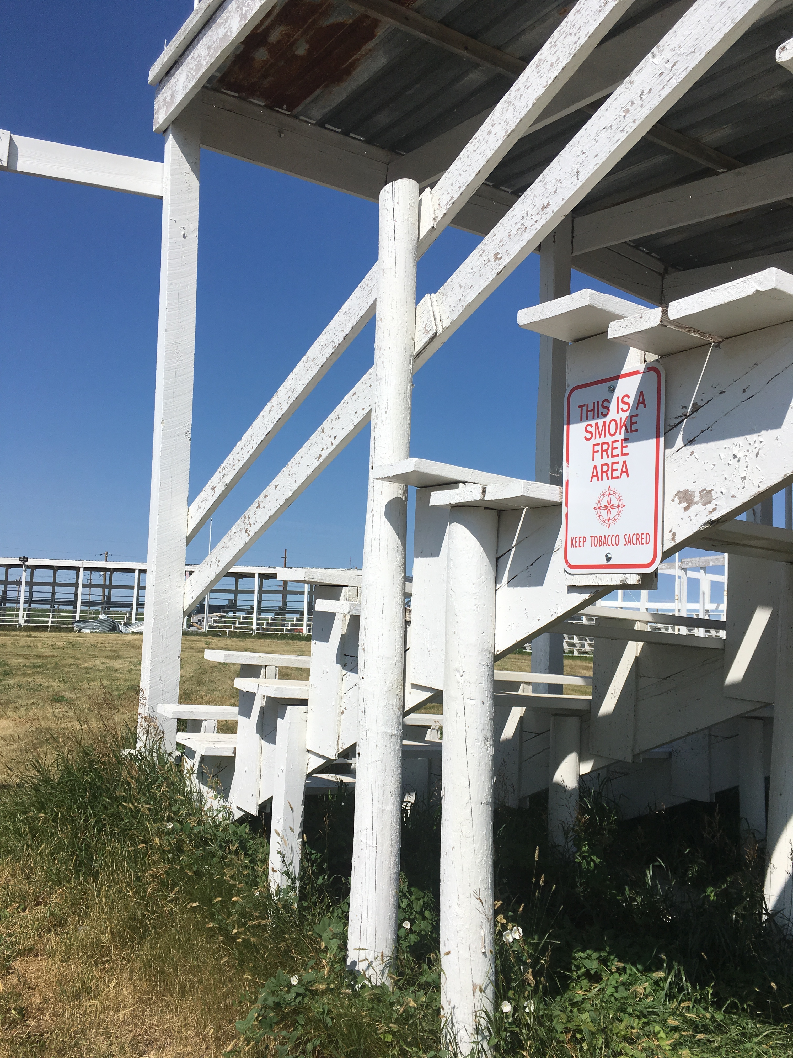
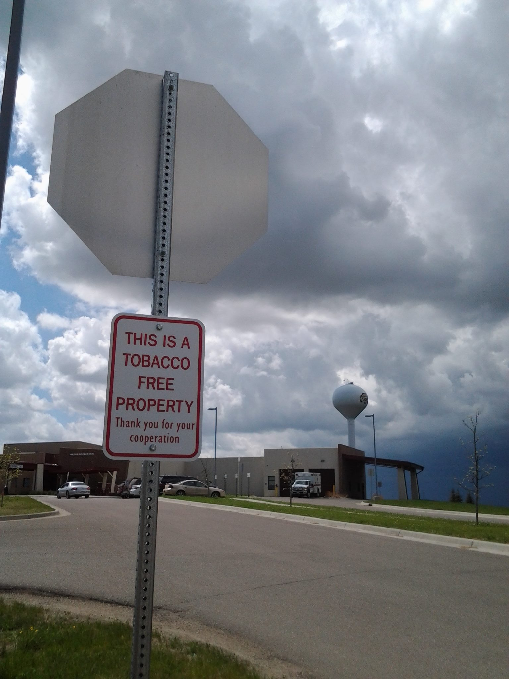
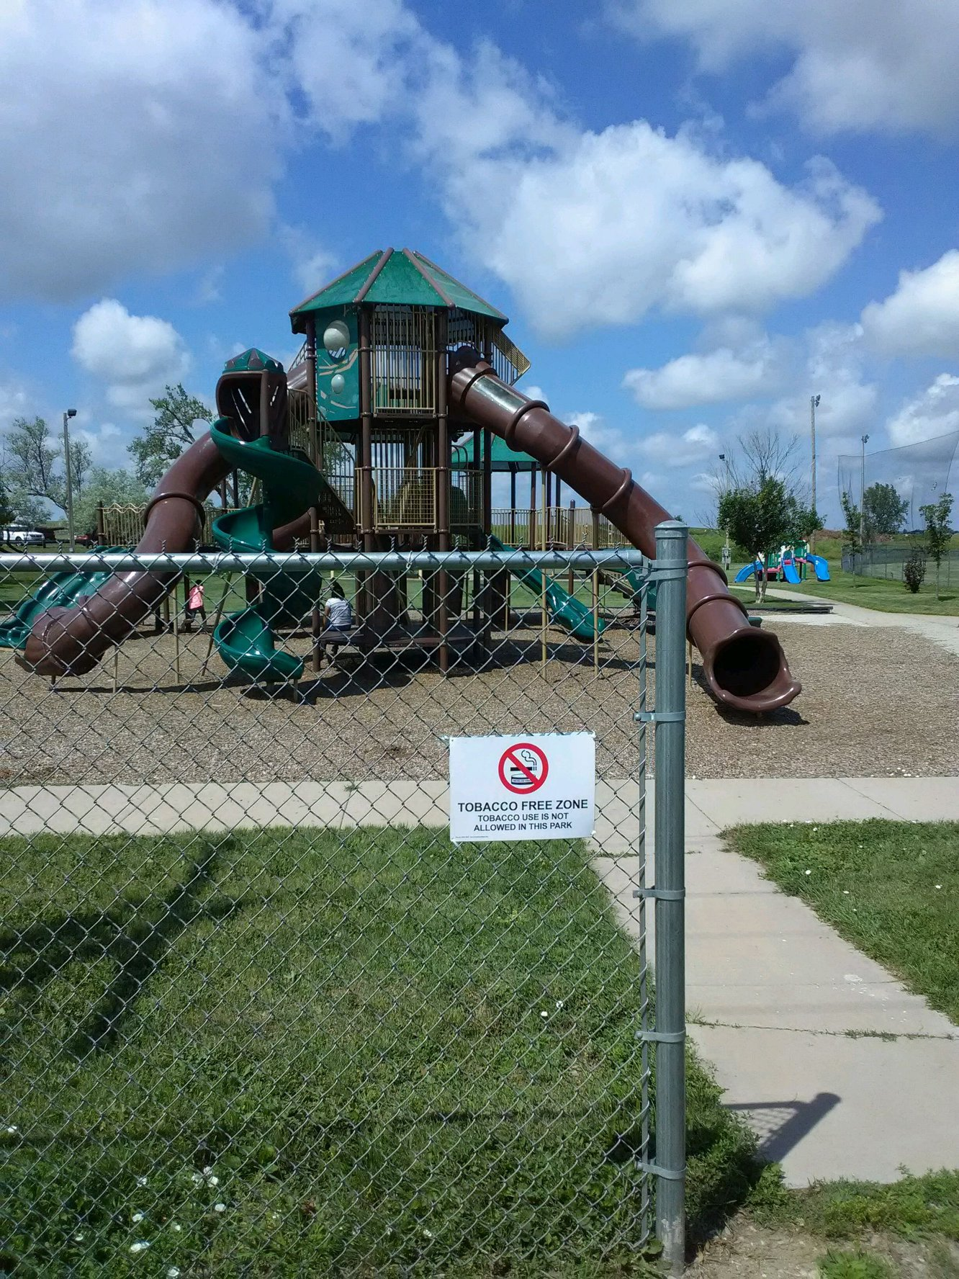
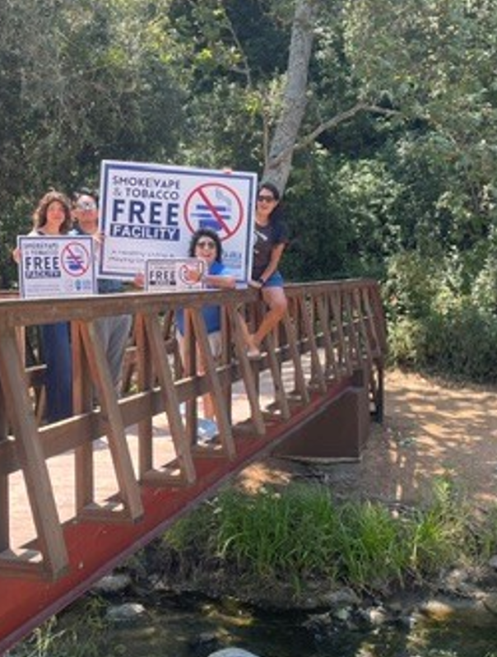
Community engagement activity
Cultural Area:
Health Center:
Recreation Areas:
Body of Water:
Notes:
Prompts for each area to be on screen and at each station or put on things to consider at each from facilitation guide?
Station 1: Cultural Area or Ceremonial Grounds
Prompt:
How can a commercial tobacco-free outdoor policy support and protect cultural spaces while respecting Traditional Tobacco practices?
Consider:
What makes this space important to the community?
How should Traditional Tobacco be distinguished from commercial tobacco?
What messages or teachings could support this policy?
What challenges might arise during cultural events or gatherings?
Station 2: Health Center
Prompt:
What would a commercial tobacco-free outdoor policy around the health center look like in your community?
Consider:
How does this policy align with healing and wellness?
Who would benefit most?
What areas should be included (entrances, parking lots, walking paths)?
What education or support should accompany the policy?
Station 3: Recreation Areas (Ball Fields, Parks, Campgrounds, Playgrounds)
Prompt:
How can commercial tobacco-free outdoor spaces help create healthy environments for youth and families?
Consider:
Which recreation spaces should be priorities?
What positive community values does this policy support?
How could the policy be promoted during community events?
What barriers or concerns should be addressed?
Station 4: Bodies of Water (Lakes, Rivers, Beaches, Fishing Areas)
Prompt:
How can a commercial tobacco-free outdoor policy help protect water, wildlife, and future generations?
Consider:
What tobacco product waste concerns exist near water?
How does protecting water connect to Tribal values and responsibilities?
What areas should be covered by the policy?
What community partners could help support implementation?

Slide 23
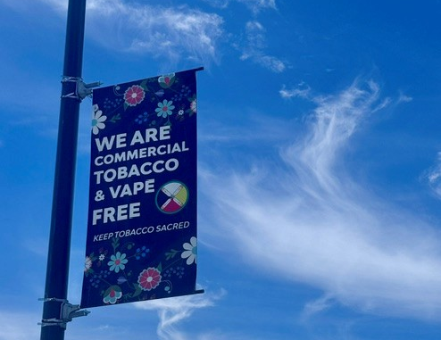
Community engagement activity: Reflection
1. Common themes across locations
2. Tool to engage Tribal community voices
3. Show up!
Notes:
What common themes or values emerged across all four locations? Were there shared priorities related to health, culture, environmental stewardship, youth, or community wellness?
Which location seems most ready for a commercial tobacco-free outdoor policy in your community, and what makes it a good starting point? What strengths, partnerships, or community support could help move the policy forward?
What is one important consideration that Tribal leaders, community members, or policy champions should keep in mind when developing a commercial tobacco-free outdoor policy? Consider cultural teachings, Traditional Tobacco, community engagement, enforcement, education, or implementation.

Slide 24
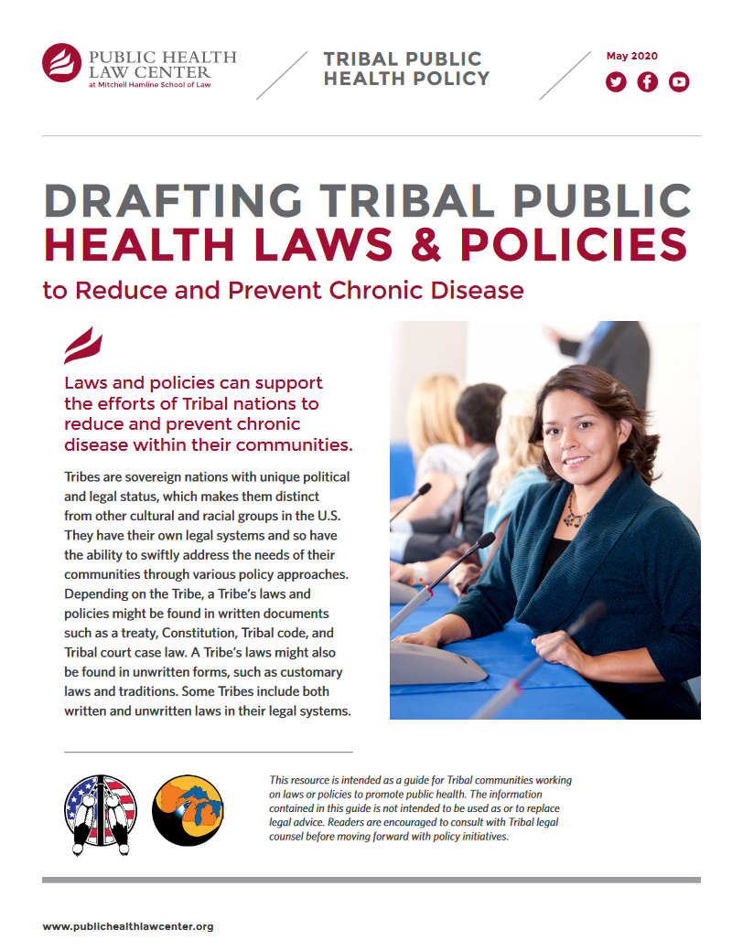
Drafting Tribal Public Health Laws and Policies
https://www.publichealthlawcenter.org/sites/default/files/resources/Drafting-Tribal-Public-Health-Laws-2020.pdf
Notes:
MORGAN

Slide 25
Legal technical assistance
Legal Research
Direct Representation
Policy Development, Implementation, Defense
Publications
Trainings
Lobby
Notes:
COLIN
When I say legal TA, I mean….
FREE
Any of you can contact us for help.

Slide 26



CONTACT US!
Colin.Welker@mitchellhamline.edu
www.publichealthlawcenter.org
facebook.com/publichealthlawcenter
Notes:
MORGAN

