Slide 1



Slide 2
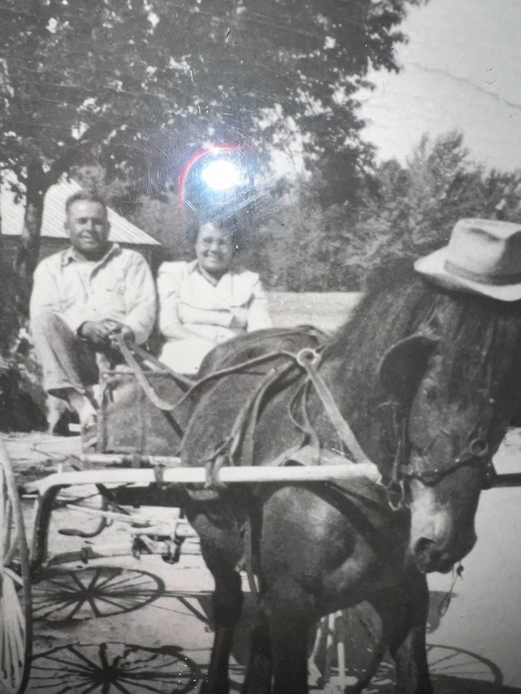
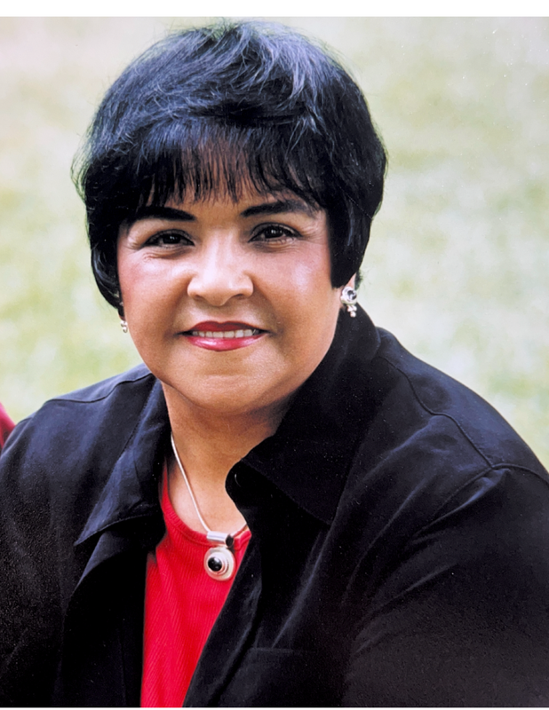
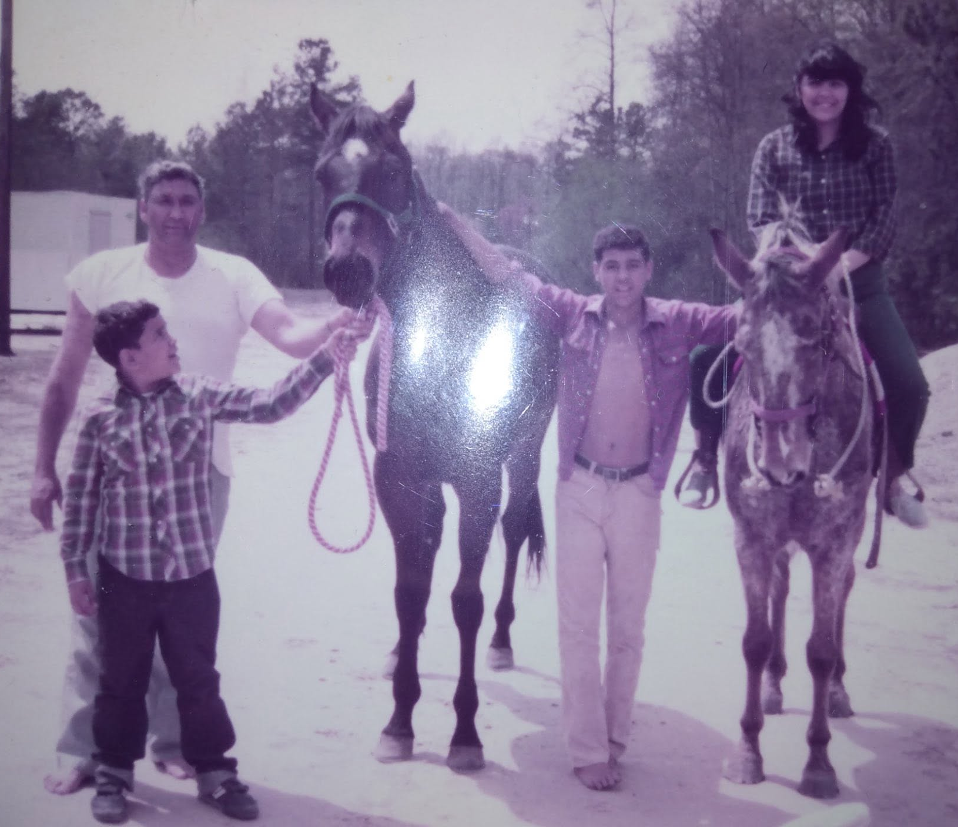
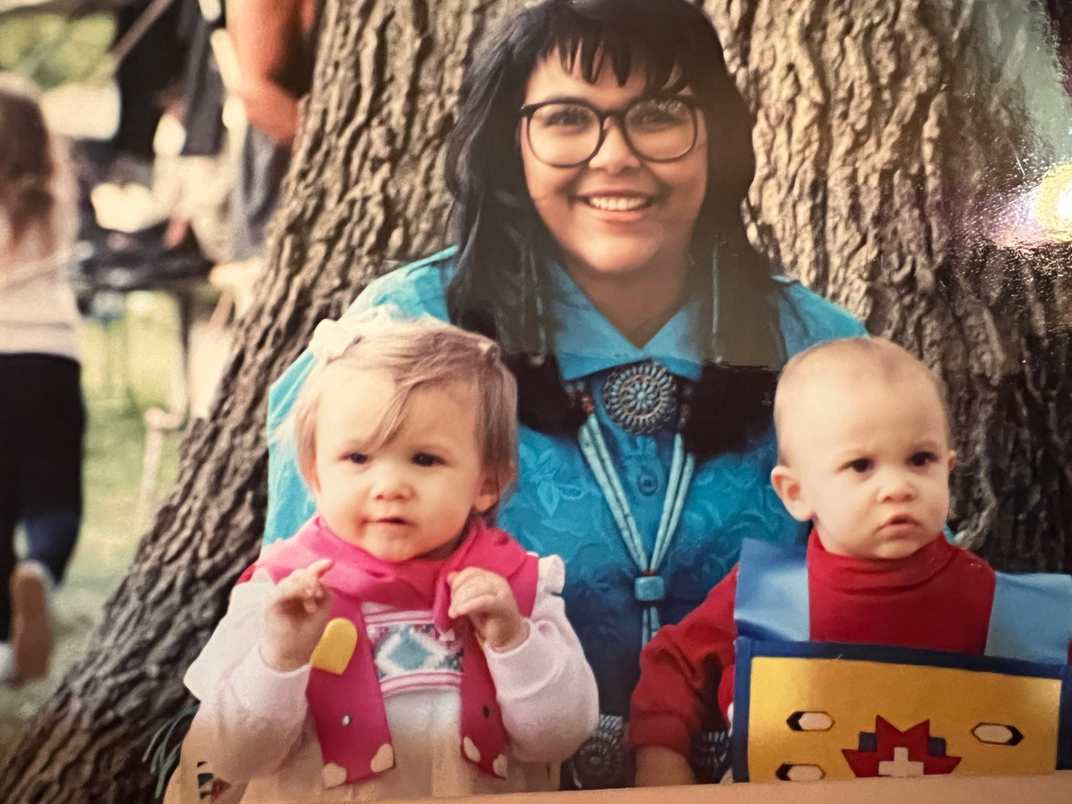
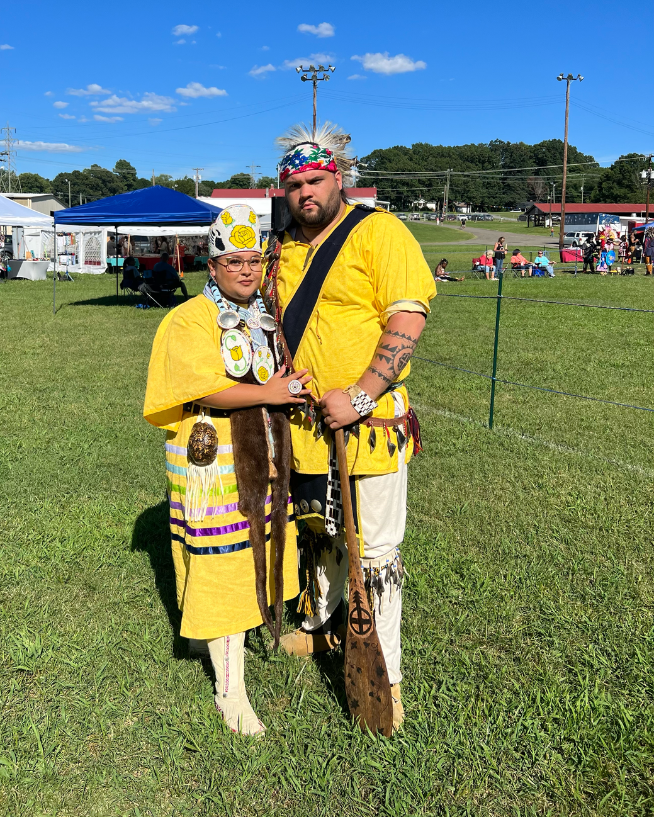
My People

Slide 3
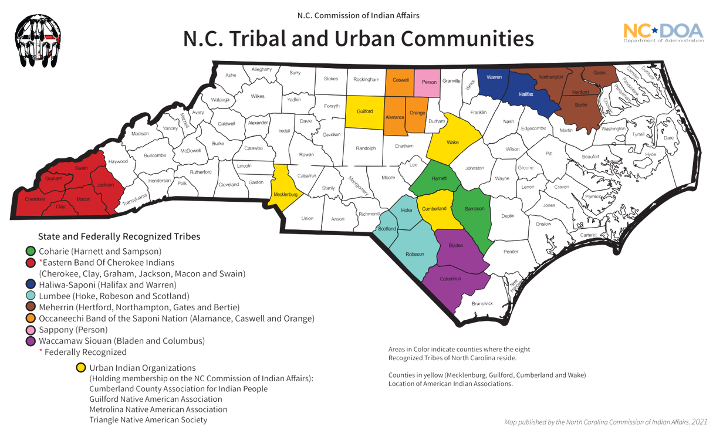
What is SAICEP?
SAICEP is a unique collaboration by the Comprehensive Cancer Centers at Atrium Health Wake Forest Baptist, Duke Cancer Institute, and UNC Lineberger.
Mission: To understand and address the cancer-related health needs of American Indian communities in our catchment areas and beyond.

Slide 4
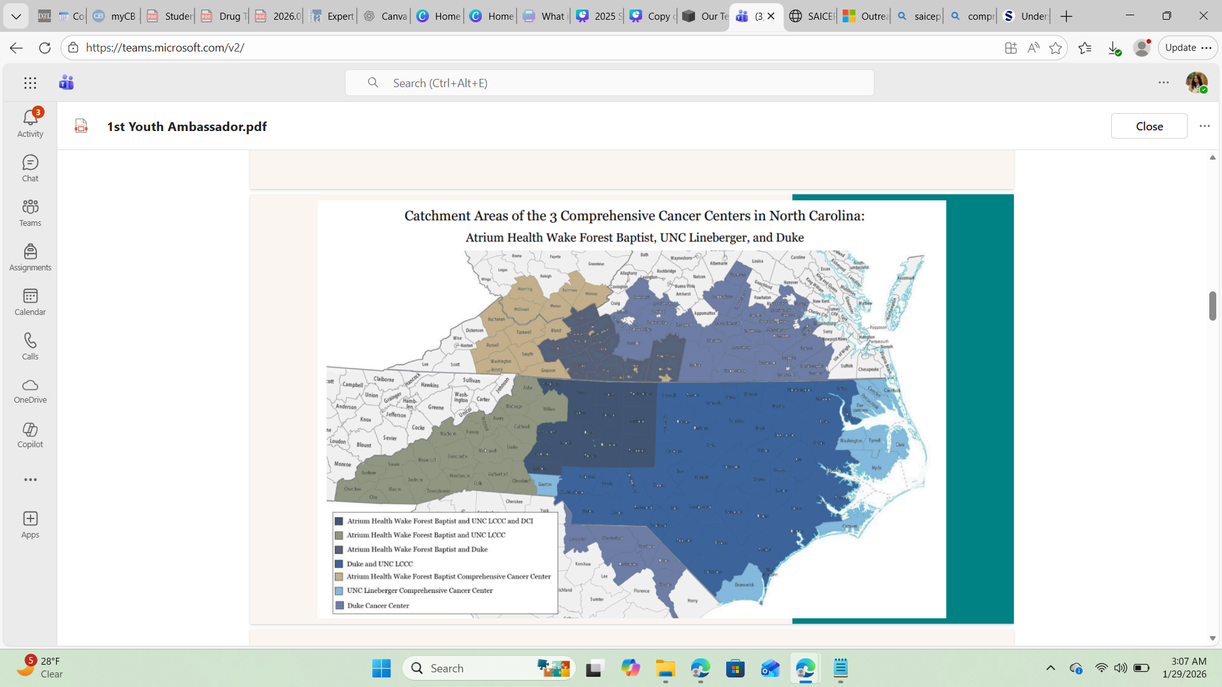

Slide 5


Areas of Engagement
Community
outreach
Research
Education
  Tribal and community powwows/festivals
  Native-led health fairs
  Native-led conferences
  Lecture series
  Presentations
  Talking Circles
  Community Advisory Board
  V-Foundation
(Years 1-4)

Slide 6
Impact in numbers
Since spring of 2021, the SAICEP team has engaged in:
51
6500+
14
Community Members reached
Events
Webinars

Slide 7
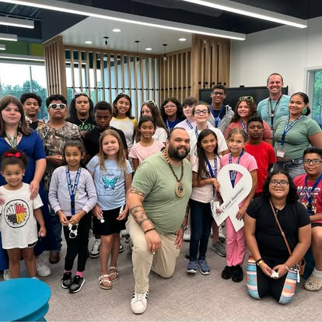
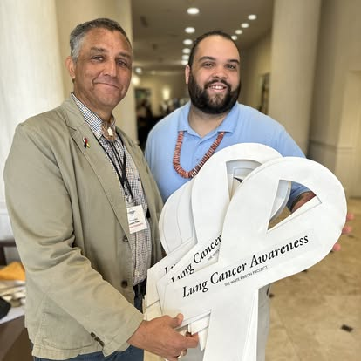
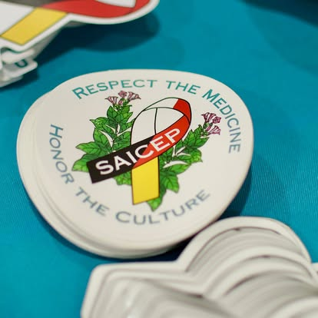
SAICEP & White Ribbon Project
  White ribbon project: non-profit organization dedicated to raising awareness about lung cancer
  Collaborated with SAICEP to understand tobacco use among AIs in NC

Slide 8
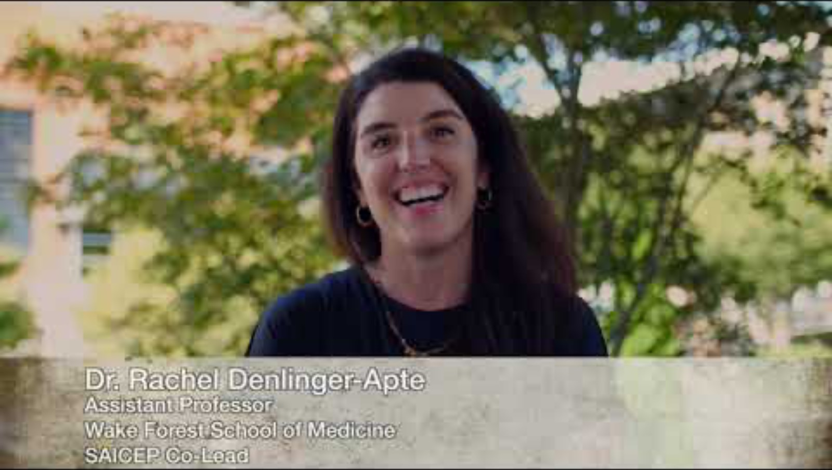

Slide 9
Special Thanks
  Joshua Chorman- videographer and editor
  Reggie Brewer (Lumbee)
  Eddie Moore (Lumbee)
  Harlen Chaivs Sr. (Lumbee)
  Laury Chavis (Lumbee)
  Rachel Denlinger
  Pierre Onda (White Ribbon Project)
  Lung Cancer Initiative
  All our ancestors that protecting and cared for us so we can continue their legacy

Slide 10
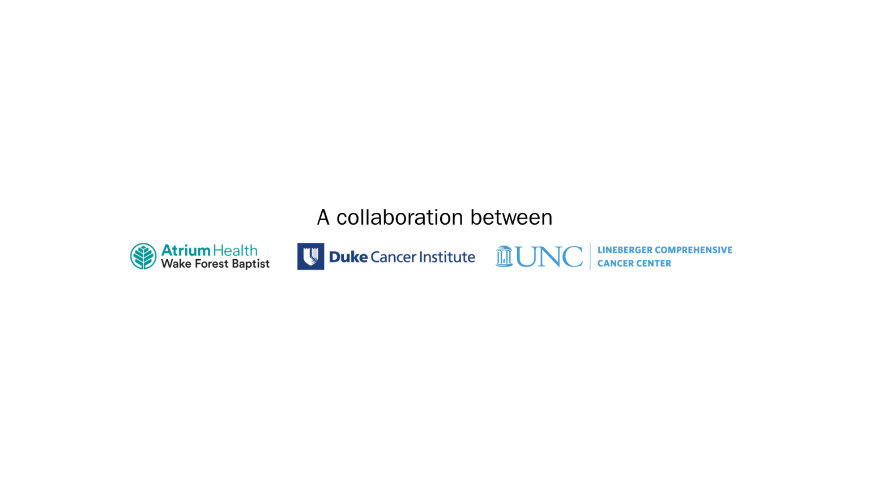
Questions?
Southeastern American Indian Cancer Health Equity Partnership

